Slide 1









My Number Interactive Notebook
$$×$$
$$\frac{1}{2}$$
$$÷$$
$$+$$
$$−$$
$$\frac{3}{5}$$
$$7$$
Name
Class
Teacher
Term 1 Semester 1
$$5^{2}$$
$$\sqrt{9}$$
1

Slide 2
Contents
Glossary or Formula Page
Page
Date
Description
2
3

Slide 3
Tasks
24
7
30
Essential Question
Questions
Notes
Summary
6
7

Slide 4
24
7
30
Date
Index Laws Review
EQ – Describe how the index laws can be used to simplify expressions with indices.
5

Slide 5

Task – 5 Questions
${(3^{2})}^{5}$
$7^{3}×7^{3}$
${\left(5×2\right)}^{3}$
$\frac{3^{4}}{3^{2}}$
${\left(\frac{3}{5}\right)}^{4}$

Slide 6


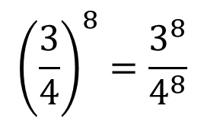

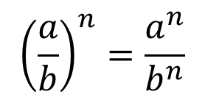



24
7
30
Date
Index Laws Review
EQ – Describe how the index laws can be used to simplify expressions with indices.
Example
What is the power of a power index law?
What is the zero power index law?
$$({a^{m})}^{n}=a^{mn}$$
$${(x^{7})}^{4}=x^{7×4}=x^{28}$$
$$({a×b)}^{n}=a^{n}×b^{n}$$
$${(6×3)}^{4}=6^{4}×3^{4}$$
$${\left(\frac{a}{b}\right)}^{n}=\frac{a^{n}}{b^{n}}$$
$${\left(\frac{3}{4}\right)}^{8}=\frac{3^{8}}{4^{8}}$$
$$a^{0}=1$$
$$9^{0}=1$$
5

Slide 7

Task
Complete page 53 from the Dwyer textbook
Extension:
Try questions 5, 6, 7, 8 and 9 from page 57

Slide 8
Notes Review
24, 7 ,30
Date
Title
Essential question
Notes complete
Notes complete with colour and diagrams
Questions completed
Contents page filled in
Formula page filled in

Slide 9
Homework
Review your notes and write a summary answering the essential question.

